Slide 1
INTEL PRODUCTS SENTIMENTAL ANALYSIS FROM ONLINE REVIEWS
JOYSH JAYARON JOSE

Slide 2
CONTENTS
01
OBJECTIVE
02
REVIEW SCRAPING
03
ML TECHNIQUES
04
SEGMENTATION
ANALYSIS

Slide 3
CONTENTS
05
EXPLORATORY DATA ANALYSIS
06
COMPETITION SENTIMENT
07
USER / EXPERT FUTURE EXPECTATIONS
08
KEY FEATURES
09
CONCLUSION

Slide 4
01
OBJECTIVE
Perform the Sentiment Analysis based on online reviews. Mainly focusing on these four aspects:
POSITIVE SENTIMENTS
NEGATIVE SENTIMENTS
USER FUTURE EXPECTATIONS
COMPETITION SENTIMENTS

Slide 5
02
REVIEW SCRAPING
Multiple Amazon pages on Intel products ranging from various cores such as i3, i7, i9 were visited & their reviews were scraped. This was done by making sure that all methods involved were legal and ethical foir web scraping.

Slide 6
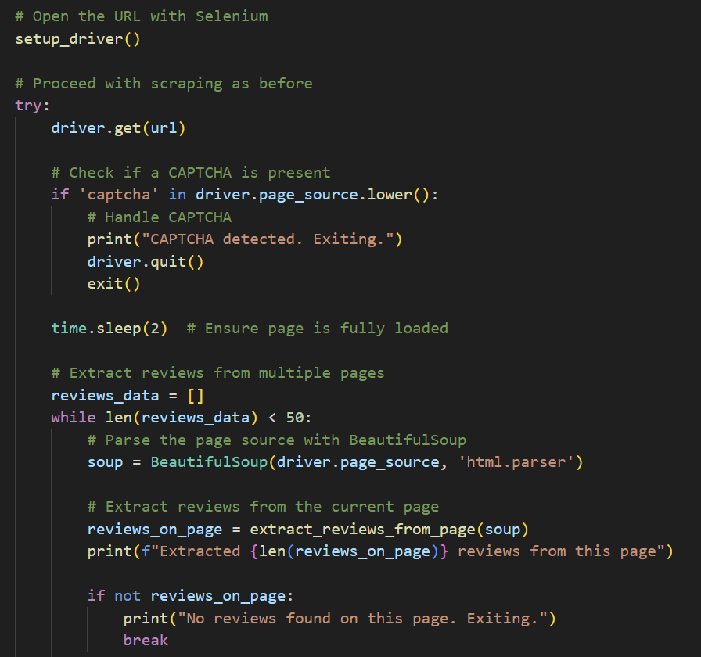
2
REVIEW SCRAPING
STEPS INVOLVED
Setting up Selenium:
Using the setup_driver a function which sets up a headless chrome browser.
Opening the URL
Handling CAPTCHA
Extracting Reviews
Navigating through pages
Error Handling
Saving Reviews

Slide 7
2
REVIEW SCRAPING
DATASET OBTAINED
A total of 200 reviews on Intel products ranging from core i3, i7, i9 desktop processors were obtained. Including their, price, power consumption, product name and user review. The reviews have been recorded in multiple languages other than English. Mainly, Portuguese,Spanish and Franch.
DATASET USED:
https://drive.google.com/file/d/1cfI7XwqBJ4K3Fk9kb2eqAfCgRmC-RKFz/view?usp=sharing
CODE USED FOR WEB SCRAPING:
https://drive.google.com/file/d/1lS47naTyaLItP72tJszLPPEn7tw80I6L/view?usp=sharing
ML TECHNIQUES
This data has been further used to gain data analysis, sentimental analysis & user expectations.This has been possible through Various ML Techniques.

Slide 8
03
ML TECHNIQUES
A variety of ML ( Machine Learning ) Techniques were used in order to achieve information on user expectations, Exploratory Data, Sentimental Analysis & Sentimental Scores.

Slide 9



2
ML TECHNIQUES
TOOLS / LIBRARIES USED
Some of the tools / libraries used for performing Machine Learning Tasks:
VADER
Valence Aware Dictionary and sEntiment Reasoner
TextBlob
TextBlob is a Python library for processing textual data.
Natural Language Toolkit (NLTK)
It provides tools and datasets for working with human language data
spaCy
Popular and modern Python library for advanced Natural Language Processing (NLP)

Slide 10
04
SEGMENTATION ANALYSIS
A thorough analysis using various data visualization and manipulation techniques, including statistical analysis by using text processing library, Regular Expression were performed.( Though due to limitation in knowledge & technical tools, an accurate analysis could not be performed).

Slide 11
4
SEGMENTATION ANALYSIS
TOOLS / LIBRARIES USED:
1. Data Manipulation and Analysis
pandas
numpy
2. Data Visualization
matplotlib.pyplot
seaborn
3. Statistical Analysis
scipy.stats
4. Text Processing
re ( Regular Expressions )

Slide 12
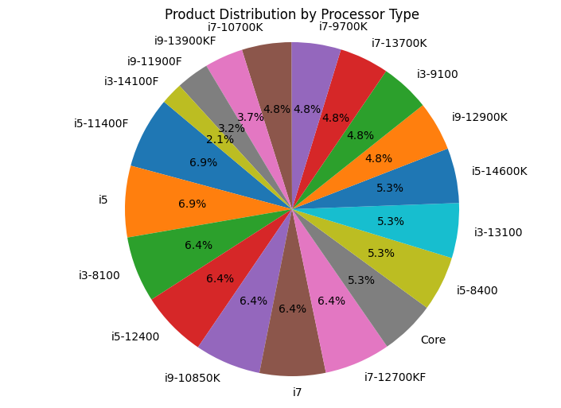
4
SEGMENTATION ANALYSIS

Slide 13
4
SEGMENTATION ANALYSIS
I have included products that range from various cores with wide variety of models: including those with and without graphics cards or CPU overclocking.
The code for segmentation analysis have provided major insights on each of the products including their power consumption & rating as seen from the data set extracted from multiple amazon reviews.
The graph derived by the code using matplotlib python library jhas suggested three main things. From the variety of products provided most of them had a steady rating of 4.0 or 4.8 out of 5. A considerable change in the power consumptions were also noted in which products likes i7-12700KF, i9-13900K have high power consumption of 125 W. Product such as Intel Core i9-13900K had a considerable high price of $464. This can also be seen in the latest release of INTEL product, that is i9-14900K, that has been release for a price around $500.
A few corrections in the line plot given below:
The second product is i9-13900K, not core ( read wrong by the program ).
Where there is, i5 it is, i5-12400F.
Where i7 is simply written, it is i7-12700 ( 12th Gen with Dodeca Core ).

Slide 14
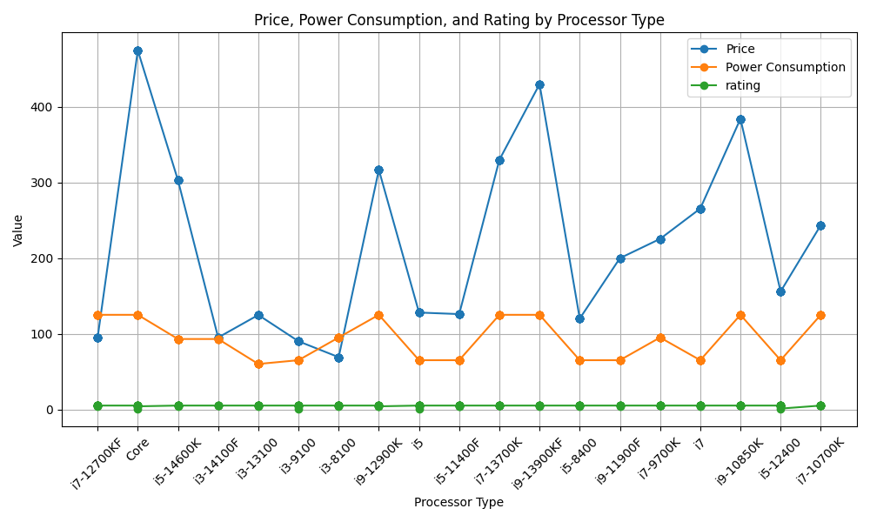
4
SEGMENTATION ANALYSIS

Slide 15
05
EXPLORATORY DATA ANALYSIS

Slide 16
5
EXPLORATORY DATA ANALYSIS
TOOLS / LIBRARIES USED:
1. Data Manipulation and Analysis
pandas
2. Data Visualization
matplotlib.pyplot
seaborn
WordCloud
3. Text Processing and Sentiment Analysis
WordCloud
vaderSentiment.vaderSentiment
4. Date and Time Parsing
dateutil.parser

Slide 17
5
EXPLORATORY DATA ANALYSIS
Data Conversion and Cleaning
Custom Date
Parsing and Handling
Plot Histograms
Sentiment Analysis
Converts the raw data “(intel_data)” into a Pandas DataFrame for easier manipulation and analysis.Also, defines a custom function to clean and parse dates
The parse function from dateutil.parser is imported to handle complex date parsing tasks.A function “custom_date_parser”is defined to clean and parse date strings.
Create histograms for Price, Power Consumption, and rating.This section
of the script focuses on visualizing the numeric data in the dataset by plotting histograms.
This section of the script performs sentiment analysis on the review texts to determine their sentiment scores, visualize these scores

Slide 18
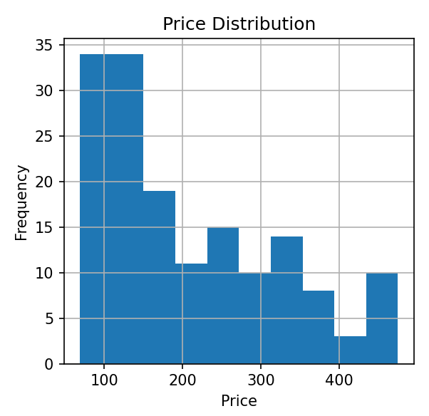
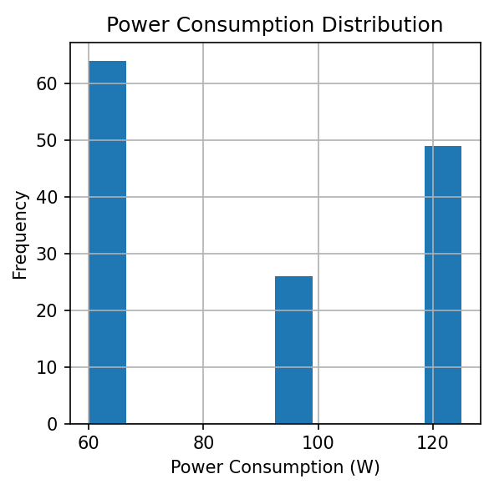
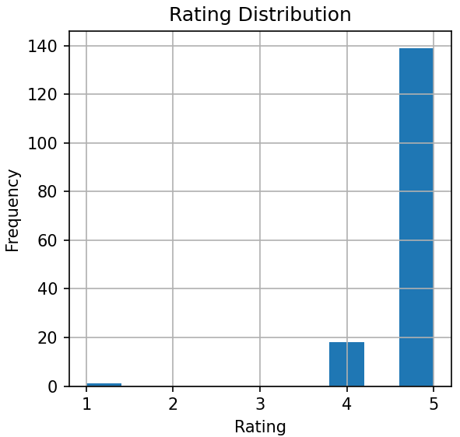
5
EXPLORATORY DATA ANALYSIS
Title
Add title
Observation: Here, the observation can be made that prices of most intel products have approximate range of 100 to 200 dollars, with a few appearing to be expensive, with prices ranging above 400 dollars.
Observation: Most intel products ranging between cores i3, i5, i7, i9 have a power consumption range between 60 - 70 W, where as a second large group of products have a power consumption ranging above 120 W.
Observation: From the review analysis and rating analysis, it can be said that most users have a good oppinion on the intel products, with a few complaining on the processor speed / technical advantages other processors have over intel.

Slide 19
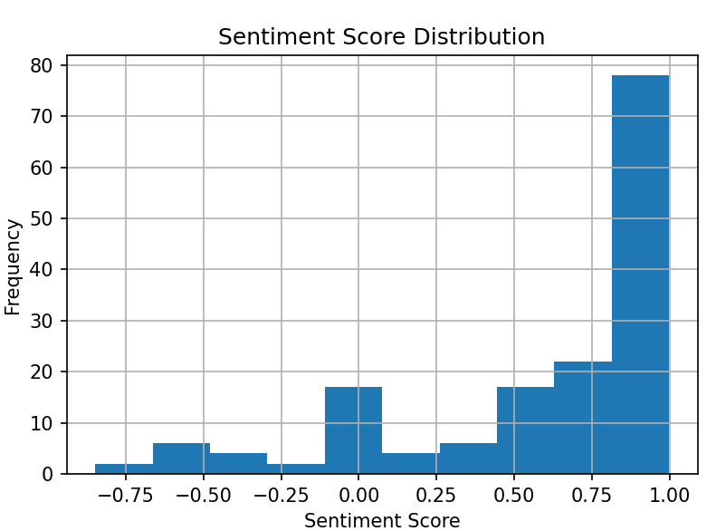
5
EXPLORATORY DATA ANALYSIS
SENTIMENT SCORE
The sentiment score distribution graph has the x axis ranging from -0.75 to 1.00 ( these scores have been calculated using VADER python embedded library ).
A lexicon-based approach is used for sentiment analysis in the script. The VADER sentiment analysis tool from the NLTK library is used here.
Most reviews show a positive sentiment here, with a sentiment score of 1.00. While a few reviews show a very strong negative sentiment, such as those showing below -0.75 ( closer to -1 ). The overall product quality is a satisfying factor for many users.

Slide 20
06
COMPETITION SENTIMENTS

Slide 21
6
COMPETITION SENTIMENTS
TOOLS / LIBRARIES USED:
1. Text Processing
NLTK
TextBlob
2. NLP Techniques
Tokenization
Stopword Removal
3. Data Visualization
matplotlib.pyplot
networkx

Slide 22
6
COMPETITION SENTIMENTS

Slide 23
6
COMPETITION SENTIMENTS
STEPS INVOLVED IN CALCULATING COMPETITION SENTIMENTS
1
Extract Reviews containing Competitor’s names
First, it tokenizes the text into sentences. Second, it searches for sentences containing the Competitor’s name. Third, it extracts it & their preceding sentences.
2
Calculate the Sentiments
Uses TextBlob to calculate the sentiment polarity score. Then, classifies sentiment as 'Positive', 'Negative', or 'Neutral' based on the score.
Generate Sentiment Scores
3
For each review, extracts sentences containing competitors’ names. Calculates sentiment scores for these sentences and stores sentiment scores for each competitor.

Slide 24

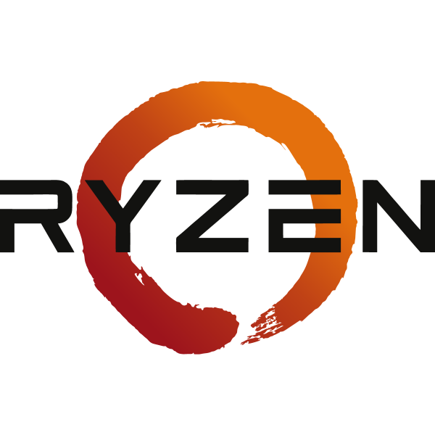

6
COMPETITION SENTIMENTS
From the given calculations and sentiment scores given, people have conducted a significant comaprison between Intel & AMD / Ryzen.
AMD
Ryzen has also been a subject of topic with a highest sentiment score ranging above 6.0 & the lowest being -0.2 ( meaning a negative sentiment ).
RYZEN
NVIDIA showed a higher positive sentiment score compared to the other competitors, with a score above 0.8.
NVIDIA
Add your words here,according to your need to draw the text box size

Slide 25
07
USER / EXPERT FUTURE EXPECTATIONS

Slide 26
7
USER / EXPERT FUTURE EXPECTATIONS
TOOLS / LIBRARIES USED:
1. Data Manipulation
defaultdict (from collections)
2. Sentiment Analysis
SentimentIntensityAnalyzer (from NLTK)
VADER Lexicon (part of NLTK)
3. Natural Language Processing (NLP)
NLTK (Natural Language Toolkit)
spaCy

Slide 27
7
USER / EXPERT FUTURE EXPECTATIONS
STEPS INVOLVED:
1. Define Aspect Categories: Categorize words into aspects such as ‘Product Usage’, ‘CPU Performance’.
2. Preprocess Data: Clean data, remove stopwords, tokenize, perform POS tagging, and sentiment analysis.
3. Extract Positive Sentiments: Identify positive reviews and compile documents from nouns and verbs.
4. Apply Topic Modeling: Use TF-IDF and LDA to find topics in positive reviews.
5. Visualize Results: Plot pie charts showing aspect distribution within each topic.
6. Analyze Specific Aspects: Calculate and print user expectations for specific aspect words.
7. Save Results: Save the analysis to an Excel file.

Slide 28
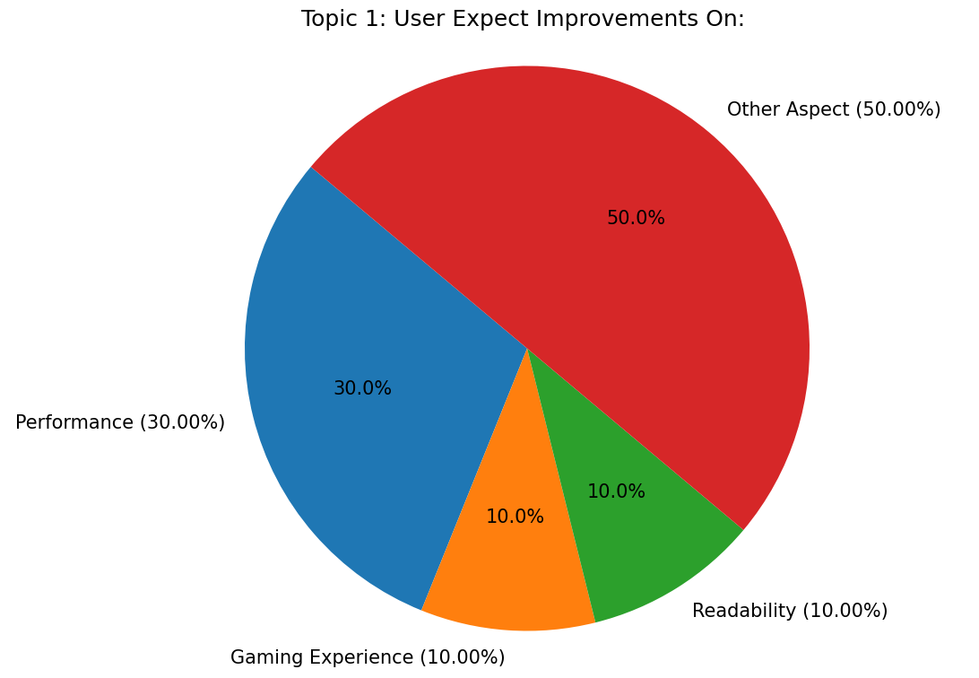
7
USER / EXPERT FUTURE EXPECTATIONS

Slide 29
08
KEY FEATURE EXTRACTION

Slide 30
8
KEY FEATURE EXTRACTION
TOOLS / LIBRARIES USED:
1. Data Manipulation
defaultdict (from collections)
2. Sentiment Analysis
SentimentIntensityAnalyzer (from NLTK)
VADER Lexicon (part of NLTK)
3. Natural Language Processing (NLP)
NLTK (Natural Language Toolkit)
spaCy

Slide 31
8
KEY FEATURE EXTRACTION
STEPS INVOLVED:
1. Extraction of key features: To parse and extract key details from a product name string, particularly focusing on CPU details.
2. Sentiment Analysis: The function evaluate_sentiment uses the VADER sentiment analysis tool to evaluate the sentiment of a given text string.
3. Analysis Process: Analyzes its sentiment, and categorizes it as positive, negative, or neutral based on specific keywords and the sentiment score.
4. Extract the features & print: For each product, the technical features are extracted and displayed along with sentiment analysis for each feature (excluding the model).
5. Processing Data: Processes a list of product data, extracts features, evaluates sentiment, and prints results, ensuring no duplicate models are processed.

Slide 32
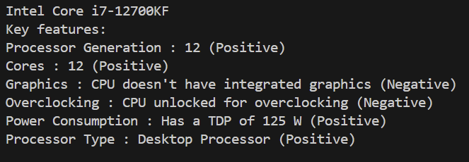
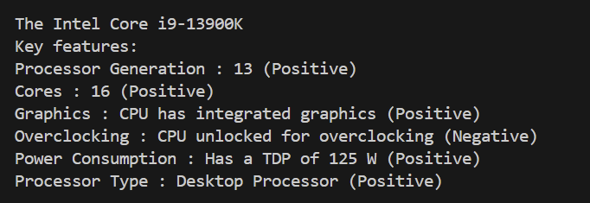
8
KEY FEATURE EXTRACTION
Feature extraction for
Intel Core i7-12700KF
Feature extraction for
Intel Core i9-13900K
The model successfully extracts the features from the dataset extracted & showcases the features in a detailed manner along with the sentiments attacthed to it. The sentiments relate to the corresponding features, capturing the sentiment scores such that a score less than 0.5 indicates negative and more than 0.5 indicates positive.
The model successfully understand whethert the product has intgerated graphics or not & is able to understand the sentiment score behind it. The sentiments relate to the corresponding features, capturing the sentiment scores such that a score less than 0.5 indicates negative and more than 0.5 indicates positive.

Slide 33
09
CONCLUSION

Slide 34
9
CONCLUSION
The sentiment analysis, exploratory data analysis, along with a thorough segmentation analysis was conducted successfully from the data that has been scraped from various amazon review sites, on each Intel Processor core. Various embedded libraries and approaches were used as for understanding future user/ expert expectations. The dataset consists of both technical feedbacks and simple user feedbacks along with information such as Power Consumption, Rating and Reviwes which were extracted in various languages including spanish, portuguese, Japanese and English. Various competetitors were analysed and were mapped to understanding the sentiments associated with those competitors as they were mentioned. Namely, Ryzen , AMD, NVIDIA. Finally, a proper key feature extraction was conducted, where the model is able to recogonise key features such as the presence of an integrated Graphics card or the power consumption.

Slide 35
THANK YOU !

